Slide 1

Create a Form to Input Data into the Database
Web Development and Non-Relational Database
Dr. Abdelhameed Ibrahim
Assoc. Prof. of Computer Engineering

Slide 2
Learning Objectives
At the end of this session, you should be able to:
Develop a web form that enables the user to insert data into a database using a form.
6/9/2022
2

Slide 3

Learning Objectives
To achieve this, first, you must learn
Using Django web application
Creating a virtual environment (Anaconda)
Setting up Projects and Applications
Using simple Templates and tags
Creating Views and Mapping URLs
3

Slide 4
Learning Objectives
To achieve this, then, you must learn
Creating a model
Using the Admin interface
Using Django Forms
Connect the form in the template
Accepting User Input and connect it to the database
4

Slide 5


Learning Objectives
You should be ready with the following
https://code.visualstudio.com/
https://marketplace.visualstudio.com/VSCode
https://www.python.org/
https://www.anaconda.com/products/individual
5

Slide 6
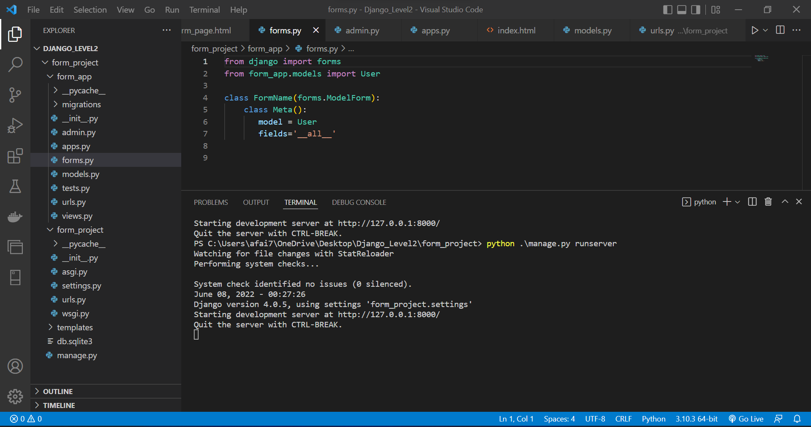

Slide 7
Learning Objectives
To achieve this, first, you must learn
Using Django web application
Creating a virtual environment (Anaconda)
Setting up Projects and Applications
Using simple Templates and tags
Creating Views and Mapping URLs
7

Slide 8
Django
Django is an open-source and free web framework.
Django is server-side technology.
Many websites utilize it, including Instagram, BitBucket, the Washington Times, and Mozilla, among others!
8

Slide 9
Learning Objectives
To achieve this, first, you must learn
Using Django web application
Creating a virtual environment (Anaconda)
Setting up Projects and Applications
Using simple Templates and tags
Creating Views and Mapping URLs
9

Slide 10
Virtual environment
Anaconda makes this simple for us!
Virtual environment with conda, use this:
conda create --name myEnv Django
Here, we constructed a "myEnv" environment using a recent version of Django.
10

Slide 11
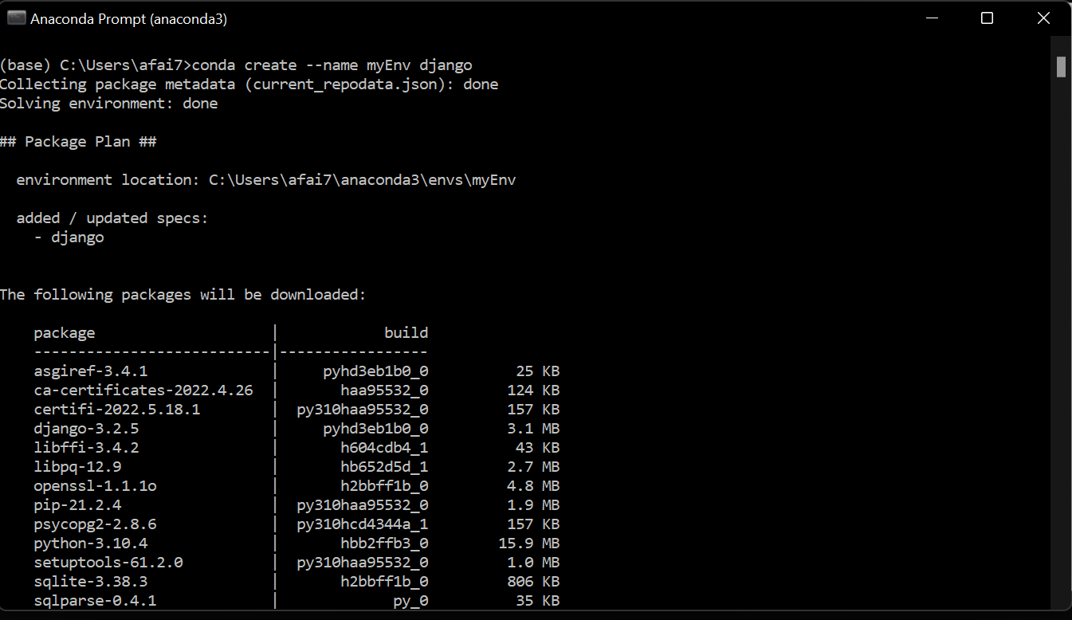
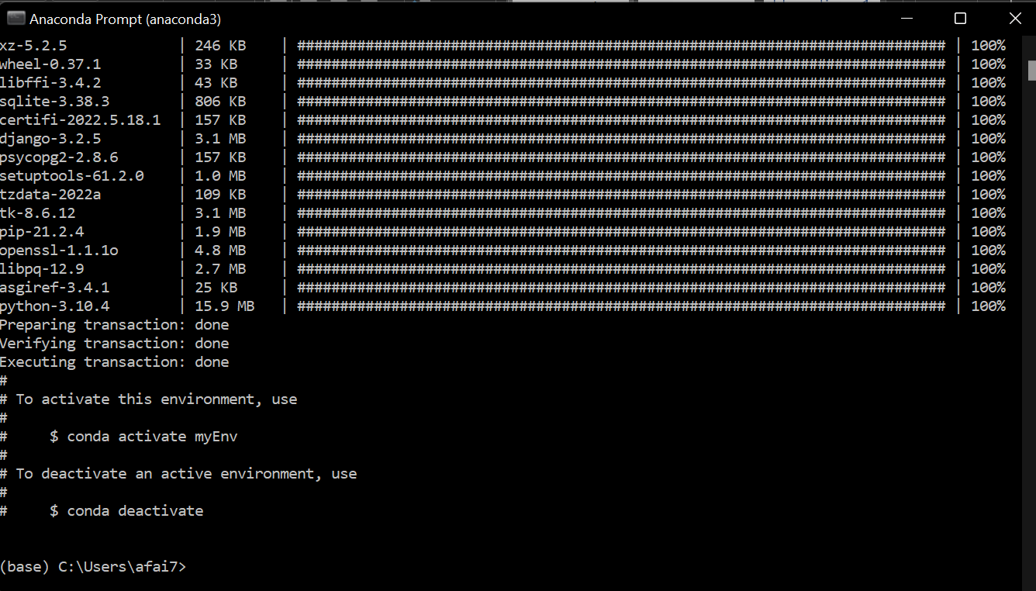
11

Slide 12
Virtual environment
Now, activate the environment:
conda activate myEnv
You can deactivate the environment.
conda deactivate
You can environment information.
conda info --envs
12

Slide 13
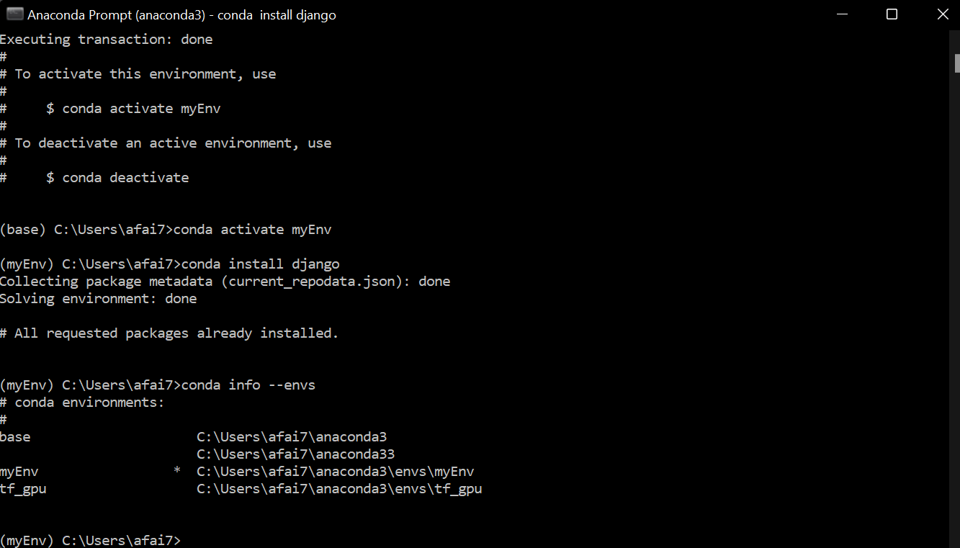
13

Slide 14
Learning Objectives
To achieve this, first, you must learn
Using Django web application
Creating a virtual environment (Anaconda)
Setting up Projects and Applications
Using simple Templates and tags
Creating Views and Mapping URLs
14

Slide 15
Django project
When you install Django, it installed a command line tool called:
django-admin
Let’s create our first project. Type:
django-admin startproject form_project
15

Slide 16
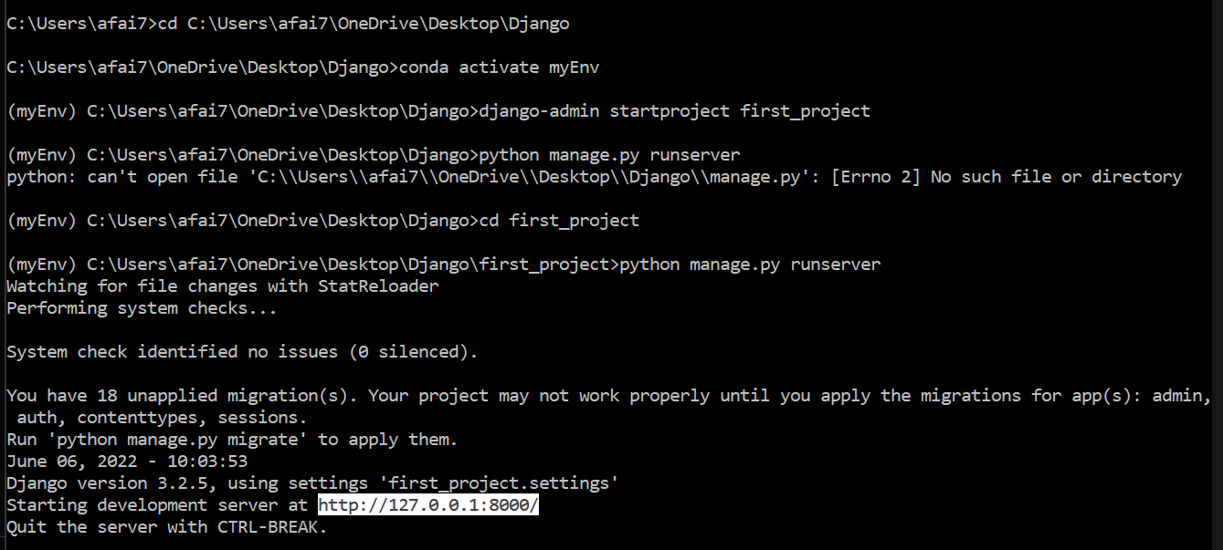
Django project

Slide 17
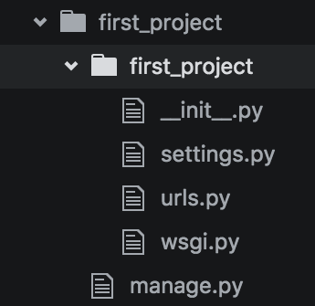
Django project
You will then receive something like this:
17

Slide 18
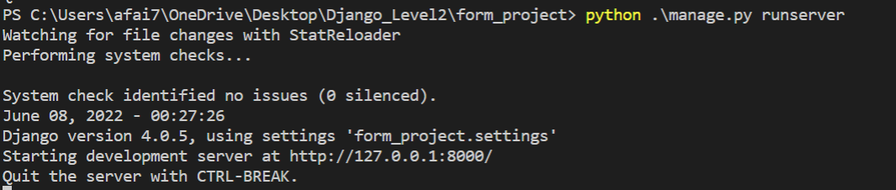
Django project
Let’s use manage.py now:
python manage.py runserver
18

Slide 19
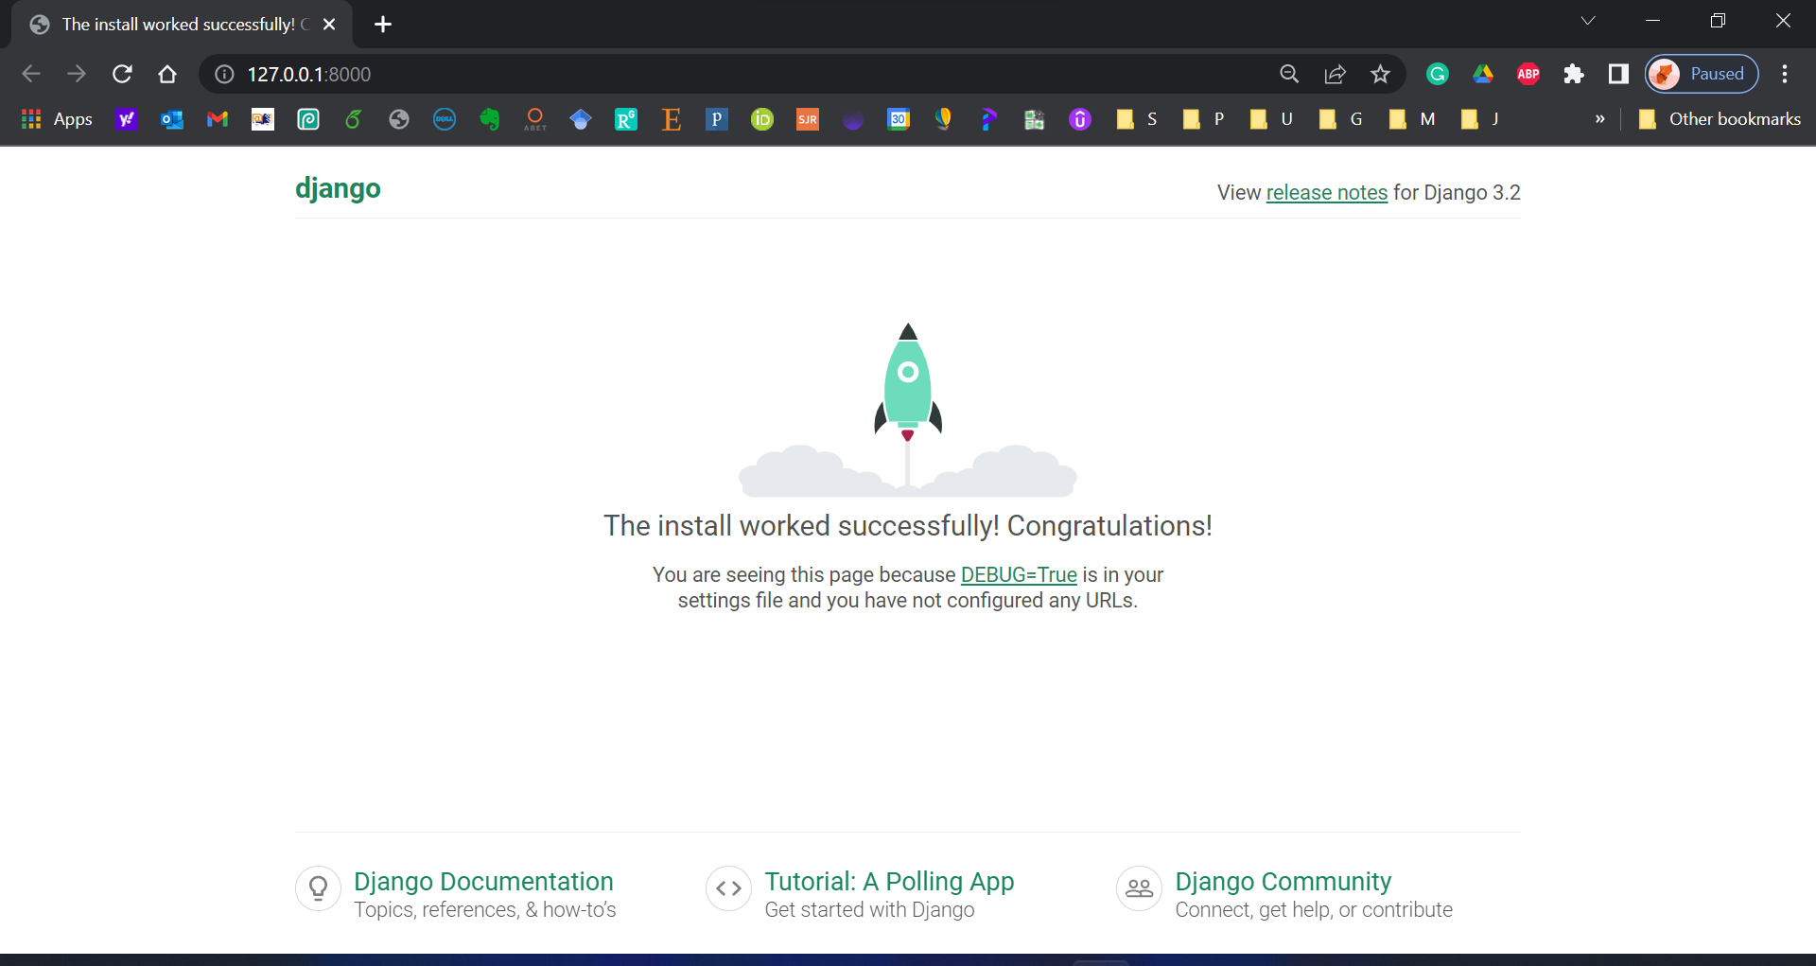
19

Slide 20
Django Application
Plug Django applications into other Django projects and reuse them! (Or use the applications of others)
Create a simple application by using:
python manage.py startapp form_app
20

Slide 21
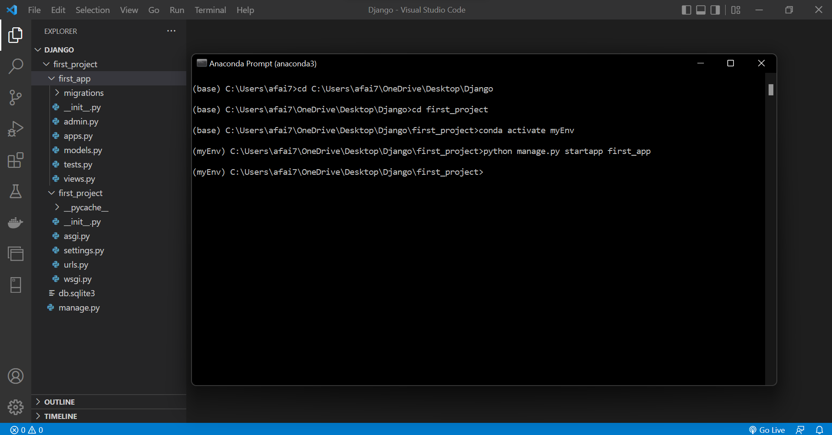
21

Slide 22
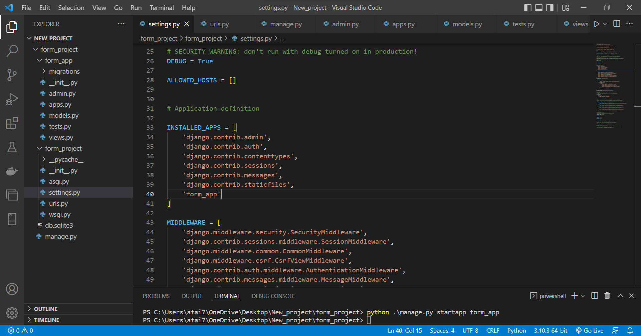
22

Slide 23
Learning Objectives
To achieve this, first, you must learn
Using Django web application
Creating a virtual environment (Anaconda)
Setting up Projects and Applications
Using simple Templates and tags
Creating Views and Mapping URLs
23

Slide 24
Using Templates
Understanding how Django functions and interacts with your website requires a thorough understanding of templates.
24

Slide 25
Using Templates
First build a templates directory followed by a subfolder for each app's templates.
It goes in your directory's top level:
first_project/templates/first_app
25

Slide 26
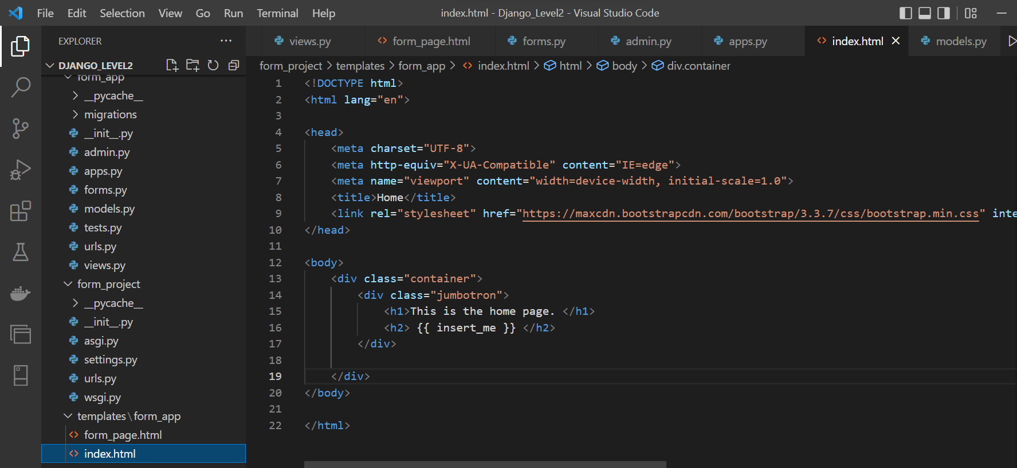
Using Templates

Slide 27
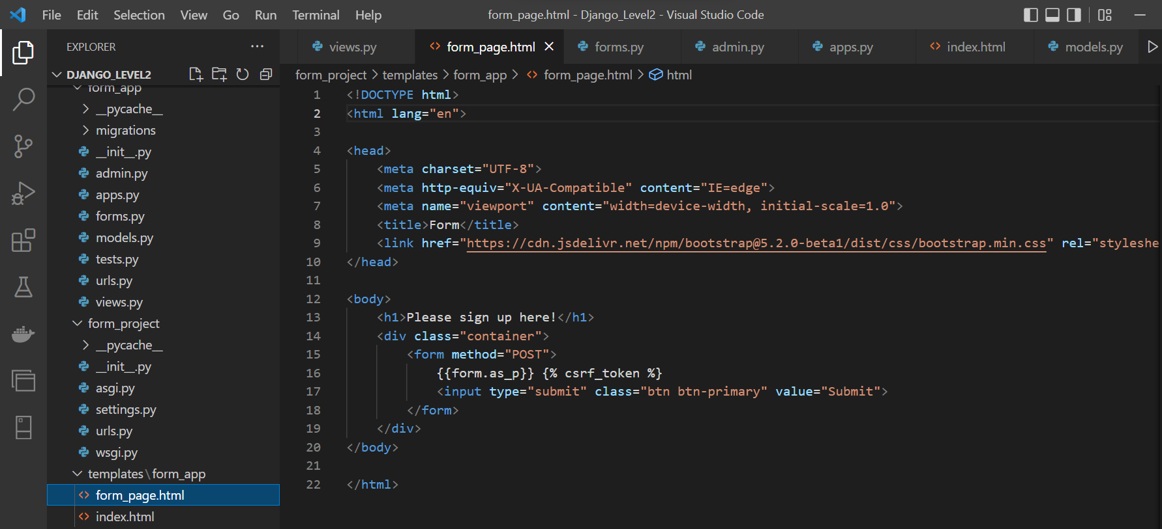
Using Templates

Slide 28
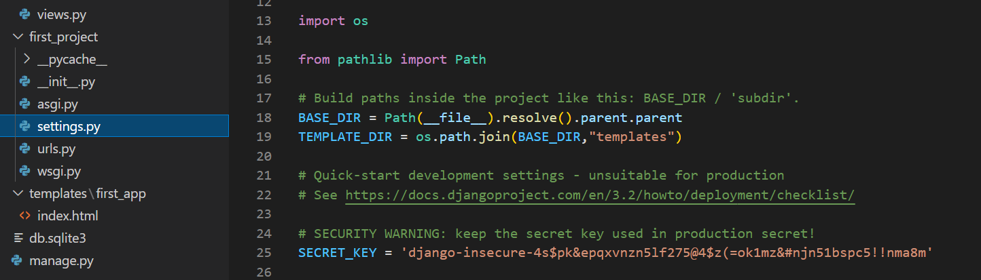
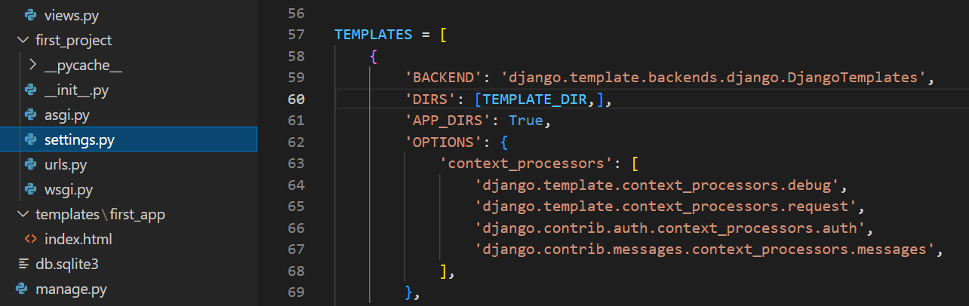
Using Templates
28

Slide 29
Learning Objectives
To achieve this, first, you must learn
Using Django web application
Creating a virtual environment (Anaconda)
Setting up Projects and Applications
Using simple Templates and tags
Creating Views and Mapping URLs
29

Slide 30
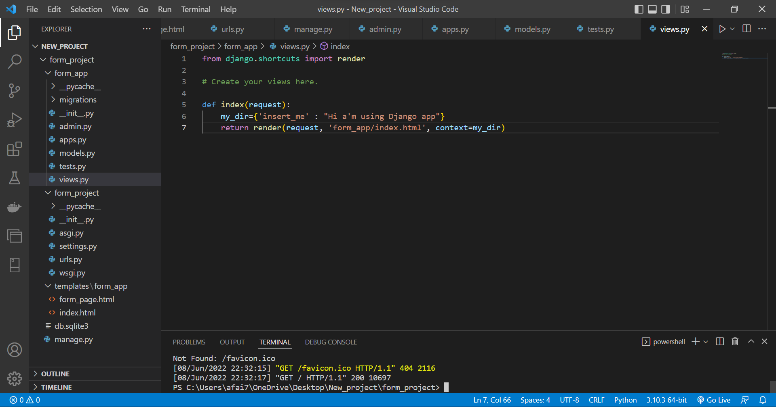

Slide 31
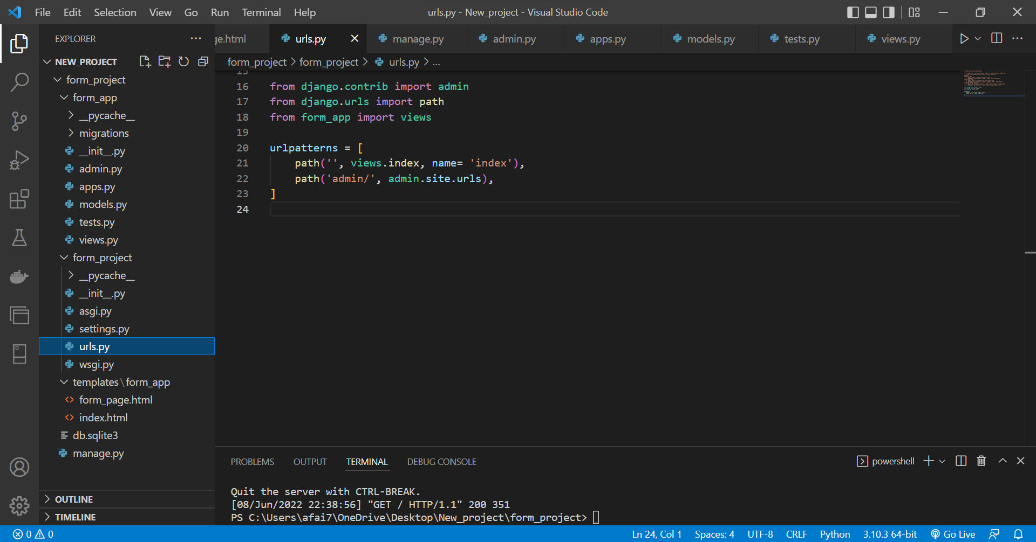

Slide 32
Django – Challenge 1
Time to put your skills to the test!
32

Slide 33
Challenge 1
Complete the following tasks:
Create a New Django Project
Create a New Django App
Create an Index View
Link this view to the urls.py file
33

Slide 34
Learning Objectives
To achieve this, then, you must learn
Creating a model
Using the Admin interface
Using Django Forms
Connect the form in the template
Accepting User Input and connect it to the database
34

Slide 35
Models
We use Models to incorporate a database into a Django Project.
To create a model, a class structure is used inside of the relevant applications models.py file
35

Slide 36
Models
This class object will be a subclass of Django’s built-in class:
django.db.models.Model
Then each attribute of the class represents a field
36

Slide 37
Models
Here is what you have to do:
Add a new model called User
It should have these fields:
First Name
Last Name
Email
37

Slide 38
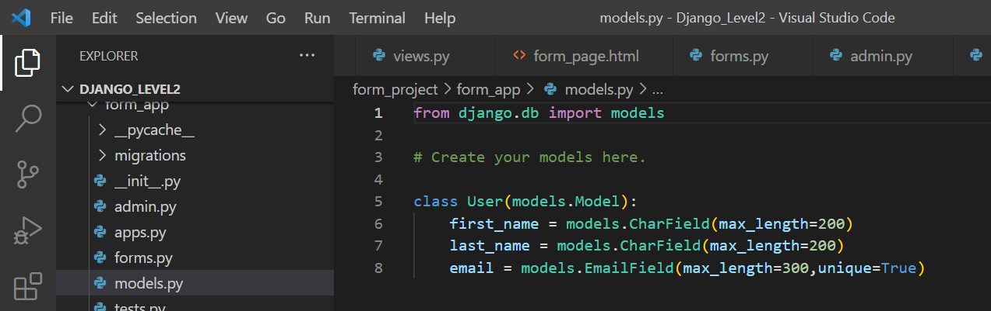
Models
38

Slide 39
Models
Migrate the database (creating databases that correspond to the models we created)
python manage.py migrate
python manage.py makemigrations form_app
python manage.py migrate
39

Slide 40
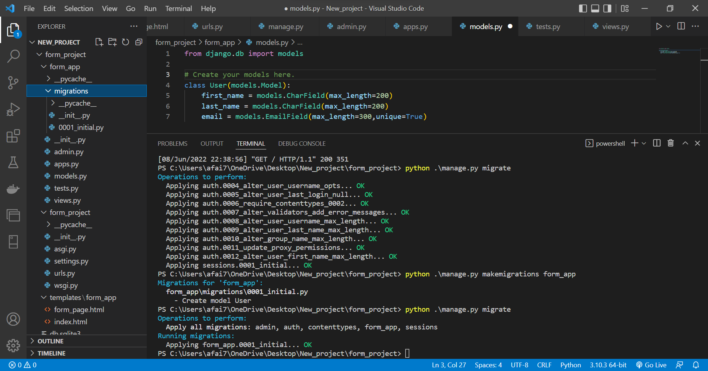

Slide 41
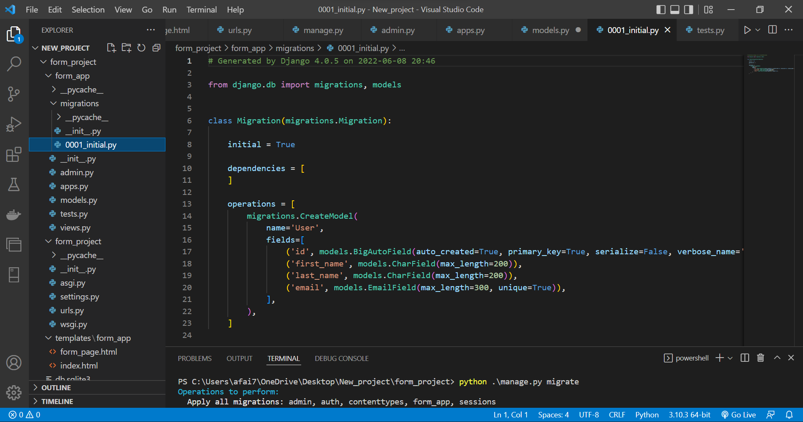

Slide 42
Learning Objectives
To achieve this, then, you must learn
Creating a model
Using the Admin interface
Using Django Forms
Connect the form in the template
Accepting User Input and connect it to the database
42

Slide 43
Django Admin interface
To use the Admin interface with the models, we need to register them to our application’s admin.py file.
admin.site.register(User)
This Admin interface is one of the key features of Django!
43

Slide 44
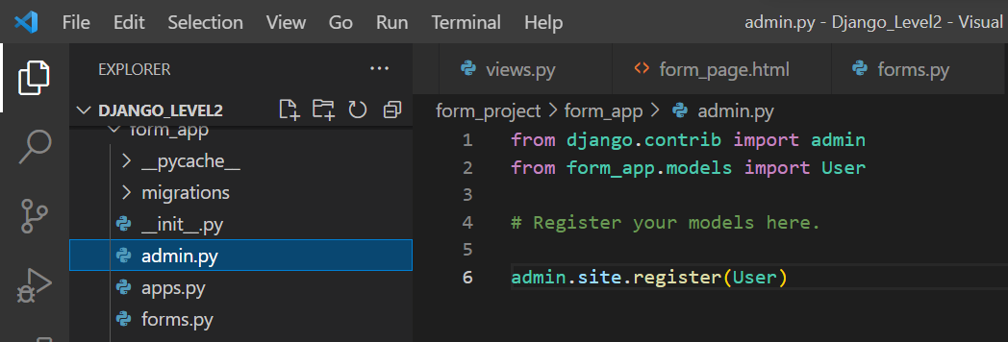
Django Admin interface
44

Slide 45
Django Admin interface
In order to fully use the database and the Admin, we will create a “superuser”
Providing a name, email, and password
Use:
python manage.py createsuperuser
45

Slide 46
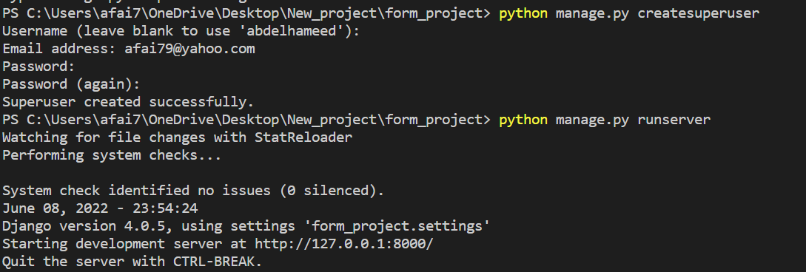
Django Admin interface
46

Slide 47
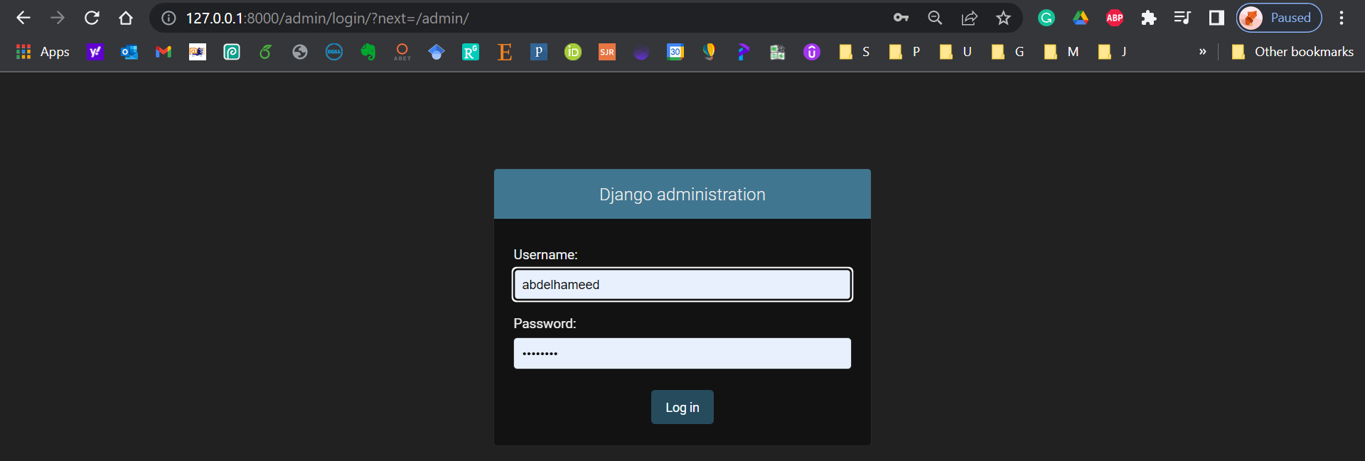
Django Admin interface
47

Slide 48
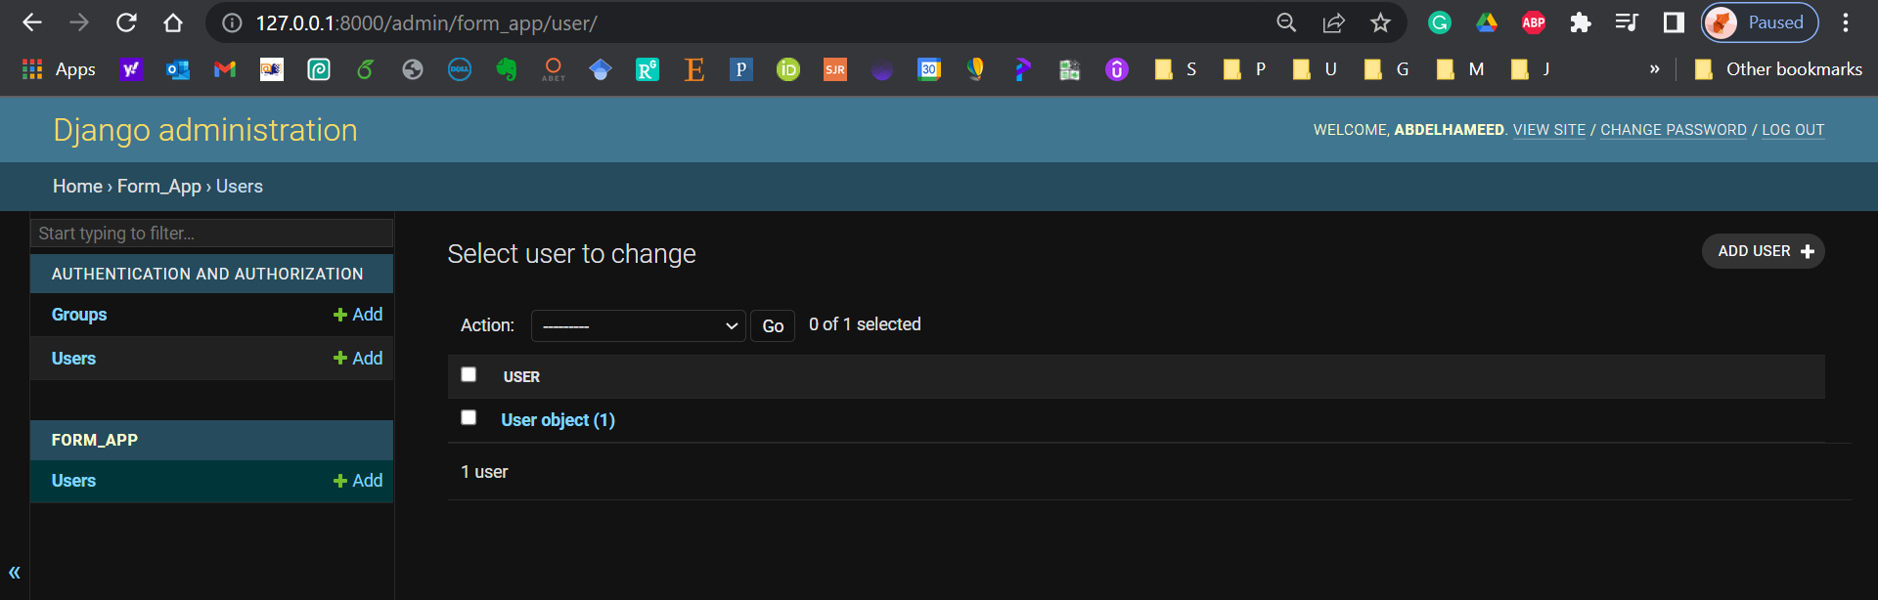
Django Admin interface
48

Slide 49
Learning Objectives
To achieve this, then, you must learn
Creating a model
Using the Admin interface
Using Django Forms
Connect the form in the template
Accepting User Input and connect it to the database
49

Slide 50
Forms
First, create a forms.py file inside the application!
Create a form from a pre-existing model, use forms.ModelForm
Meta class provides information connecting the model to the form.
50

Slide 51
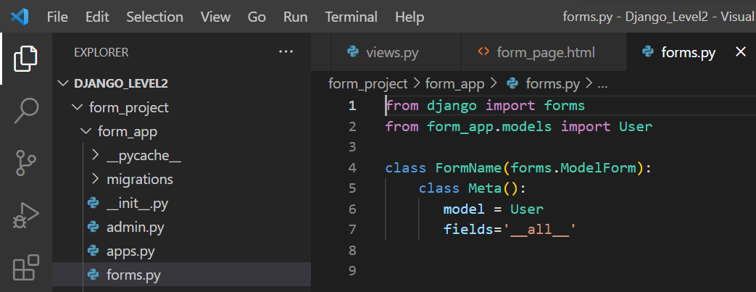
Forms
51

Slide 52
Learning Objectives
To achieve this, then, you must learn
Creating a model
Using the Admin interface
Using Django Forms
Connect the form in the template
Accepting User Input and connect it to the database
52

Slide 53
Forms
Now we need to show form created inside the application’s forms.py file by using a view!
Inside our views.py file we need to import the forms
from .forms import FormName
53

Slide 54
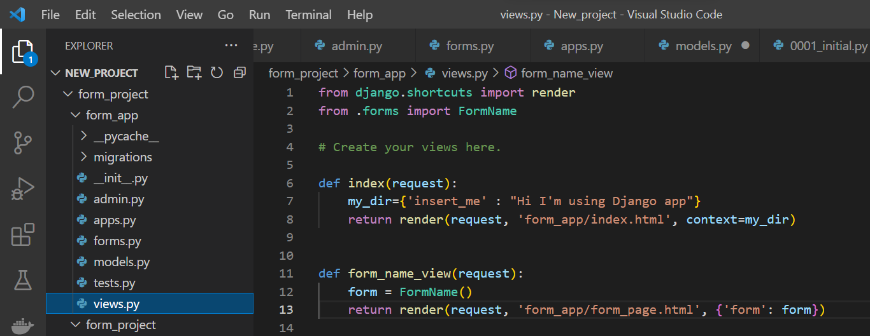
Forms, update views
54

Slide 55
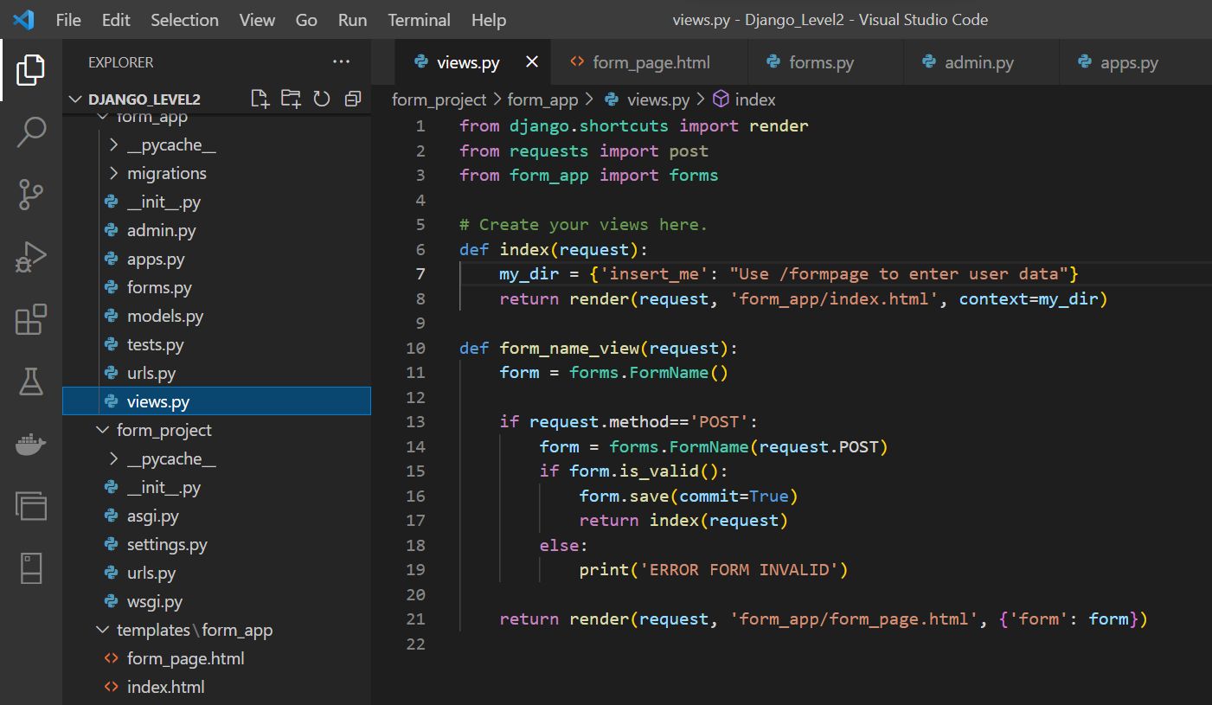

Slide 56
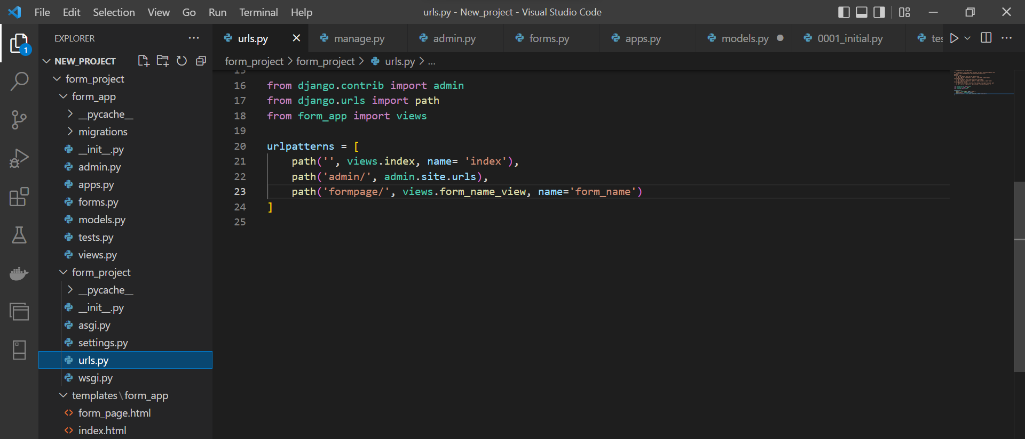
Forms, update urls

Slide 57
Forms
There are several ways you can “inject” the form using template tagging.
You can just pass in the key from the context dictionary:
{{ form }} or {{ form.as_p }}
57

Slide 58
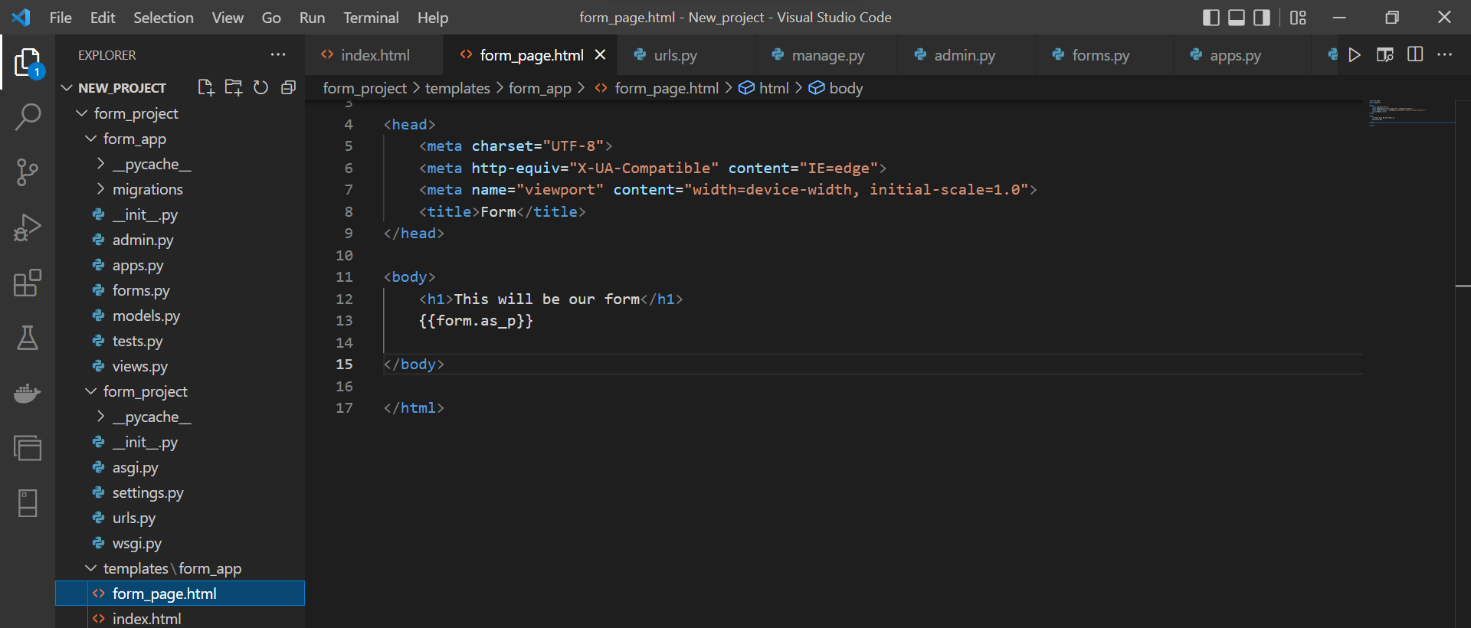
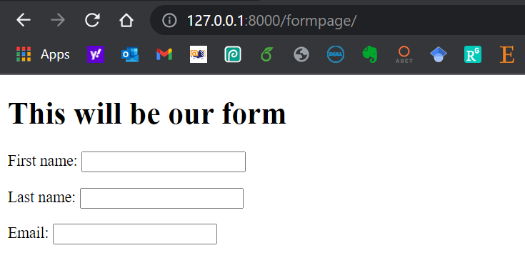
Forms

Slide 59
Learning Objectives
To achieve this, then, you must learn
Creating a model
Using the Admin interface
Using Django Forms
Connect the form in the template
Accepting User Input and connect it to the database
59

Slide 60
Forms and Models
Adding form and button to the html file
Using Bootstrap to improve the shape of the website
60

Slide 61
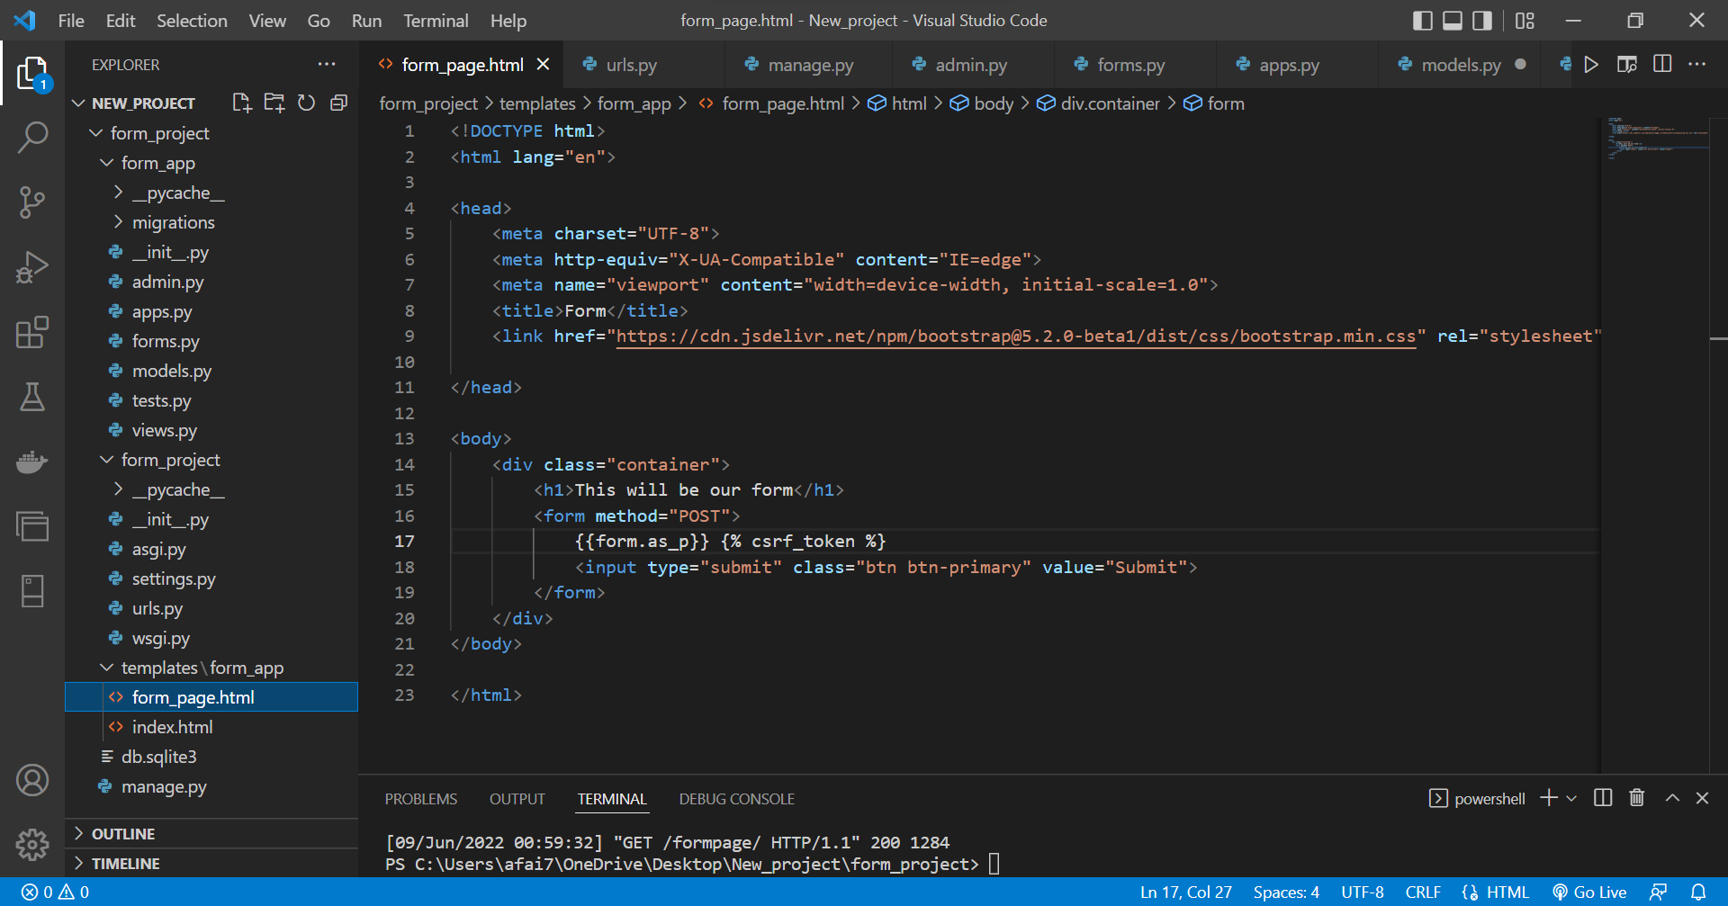

Slide 62
Forms and Models
Update views by this to save data
if request.method=='POST':
form = FormName(request.POST)
if form.is_valid():
form.save(commit=True)
return index(request)
else:
print('ERROR FORM INVALID')
62

Slide 63
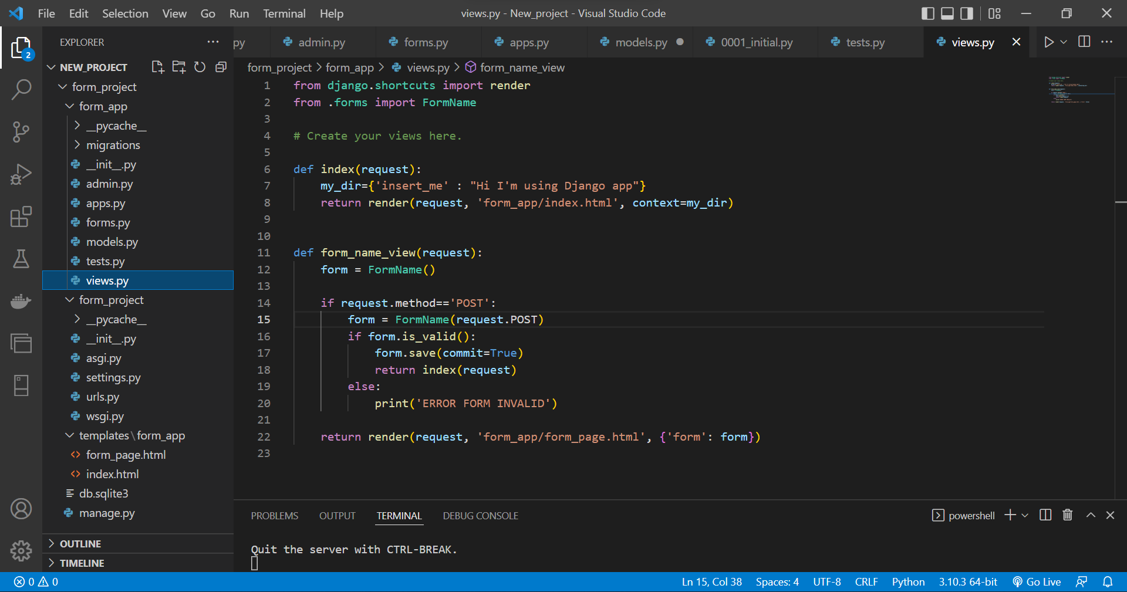

Slide 64
Model Forms - Run
64

Slide 65
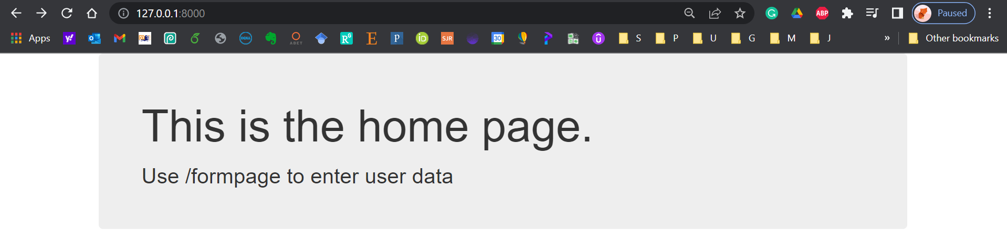
Home Page
65

Slide 66
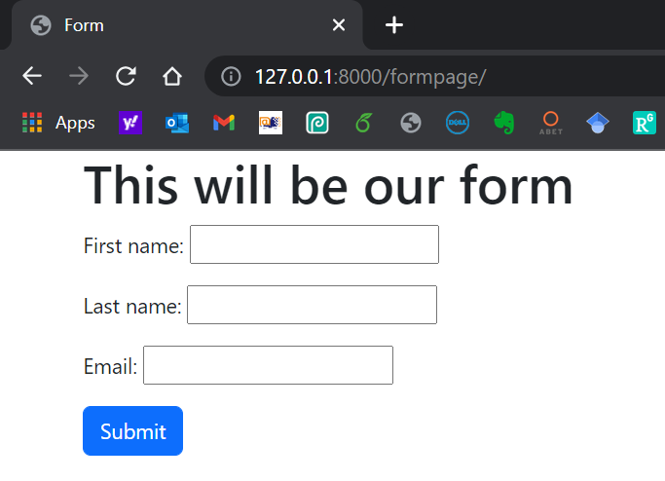
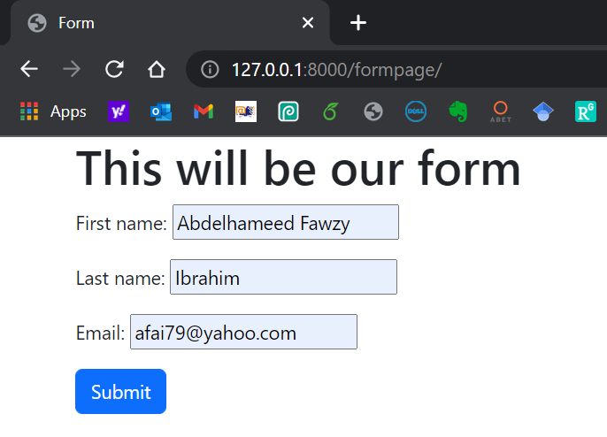
Form Page
66

Slide 67
Django Admin
67

Slide 68
Django Admin
68

Slide 69
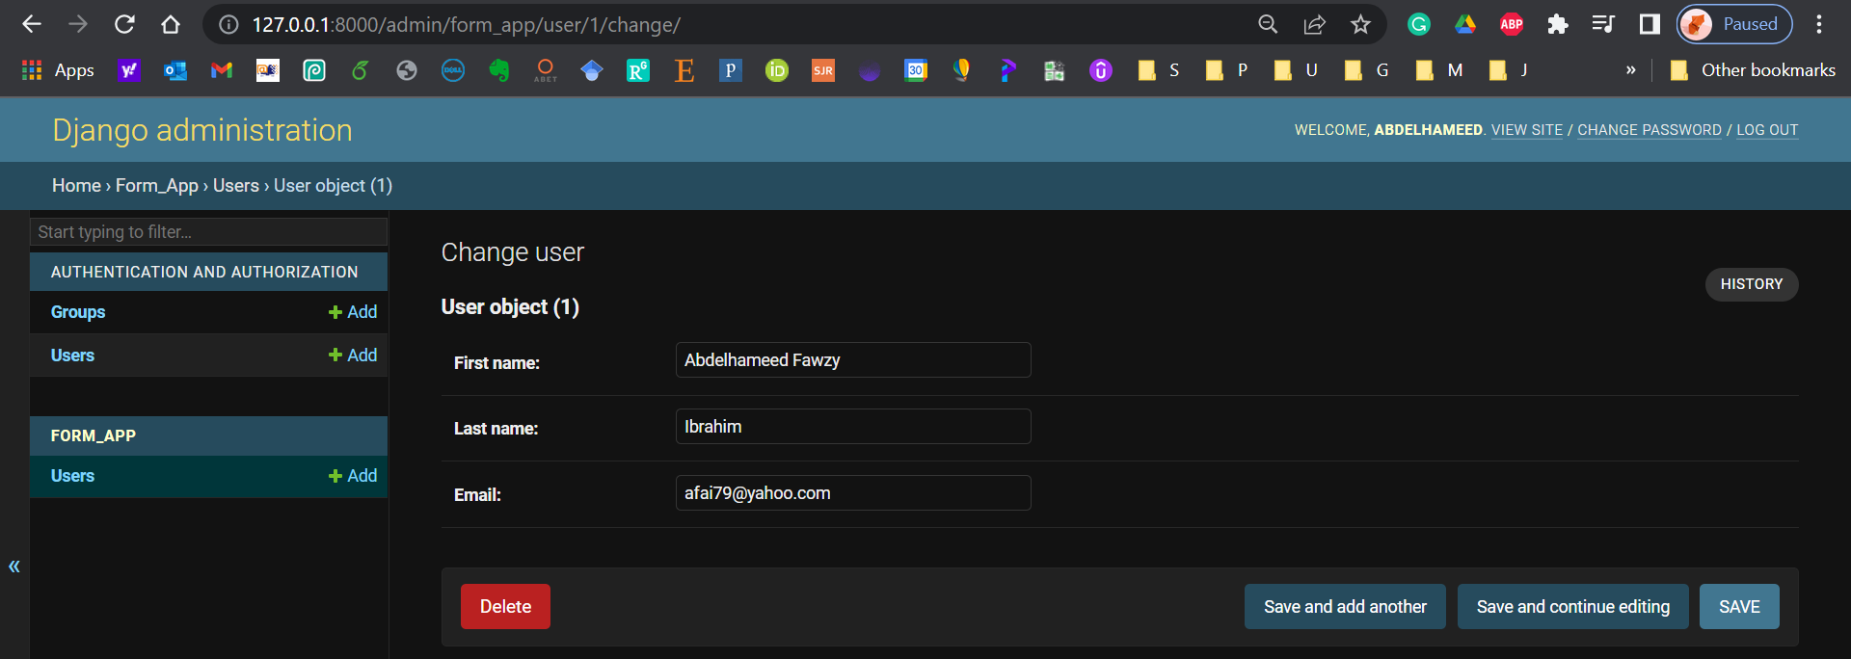
Django Admin
69

Slide 70
Learning Objectives - Confirm
You are now able to
Develop a web form that enables the user to insert data into the database using the form.
70

Slide 71

Learning Objectives - Confirm
You can download the code created in this lesson plan from my GitHub account:
https://github.com/afai79/Django-App-Forms-and-Models-
71

Slide 72
Django – Challenge 2
Model Forms
72

Slide 73
Challenge 2
Complete the following task:
Develop a Django web form that enables the user to insert data (username, password) into the database using a form (login).
73

Slide 74
Thanks
Dr. Abdelhameed Fawzy

